Slide 1

Manual Testing Mastery: Case Study with Tutorials Ninja By – Shivani Singh

Slide 2
Achievements and Highlights
Project Overview:
Successfully implemented the Page Object Model (POM) framework.
Integrated tools: Selenium, TestNG, Maven, and Extent Reports.
Test Coverage:
Enhanced test coverage with comprehensive scenarios.
Focused on critical functionalities like Wishlist, cart, and login.
Efficiency Gains:
Reduced maintenance efforts by using a modular approach.
Improved reusability and readability of test scripts.
Results
Pass Rates: Achieved high pass rates across test scenarios.
Bug Detection: Identified and resolved critical bugs early in the development cycle.
User Feedback: Received positive feedback on usability and functionality.
Kindly find the attached Link for your reference data
Copy of Test cases ^0 Bug Report ss.xlsx

Slide 3
Achievements and Results
Test Summary Report:
Project Name: Tutorials Ninja – Wishlist & Shopping Cart Functionality Testing
Prepared By: Shivani Singh
Test Case Execution Status:
Total Number of Test Cases: 75
Passed Test Cases: 58
Failed Test Cases: 17
Defect Status:
Critical Defects: 5
Major Defects: 10
Minor Defects: 2
Total Defects: 17
Objectives of the Report:
Overview of the test case execution status.
Overview of the bug report status.
Summary of the defects identified and their current status.
Suggestions for the next phase of testing.
Kindly find the attached Link for your reference data
Test Summary Report.docx

Slide 4
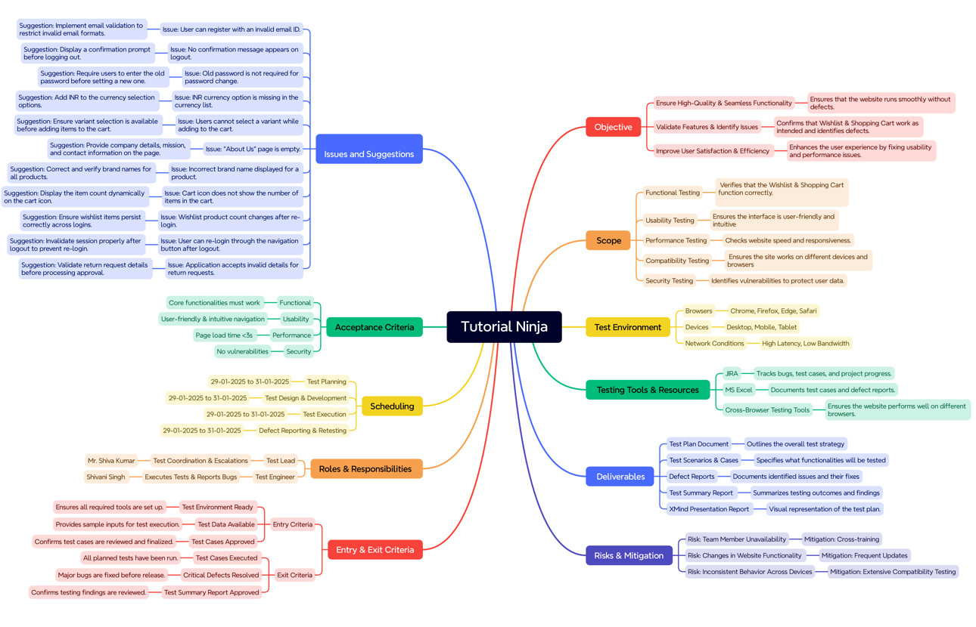

Slide 5
Objectives of the Report:
Test Execution Status: Provided a comprehensive overview of the test case execution status.
Bug Report Status: Detailed the current status of identified bugs.
Defect Summary: Summarized the defects and their severity.
Future Suggestions: Suggested next steps for the upcoming testing phase.
Key Achievements:
Enhanced Test Coverage: Successfully covered critical Wishlist and shopping cart functionalities.
Defect Identification: Identified and reported critical defects early in the development cycle.
Efficiency Gains: Achieved a high pass rate across test scenarios.
Comprehensive Reporting: Documented test execution and defect status clearly and thoroughly.
Visual Enhancements:
Graphs and Charts: Utilize bar charts or pie charts to visually represent the test case execution status and defect distribution.
Screenshots: Include screenshots of the test execution results and defect logs for visual evidence of achievements.
Conclusion:
Summary: Recap the key results and their impact on the project's success.
Next Steps: Outline the next phase of testing and improvements based on the identified defects.
Kindly find the attached Link for your reference data
Test Plan of Tutorials Ninja (1).docx

Slide 6
Key Achievements: JIRA
Enhanced Test Coverage:
Comprehensive testing of Wishlist and shopping cart functionalities.
Verified various scenarios, including adding, removing, and updating Wishlist items.
Efficiency Gains:
Achieved a high pass rate with 58 out of 75 test cases passing successfully.
Reduced maintenance efforts using a modular approach.
Defect Identification:
Identified and categorized defects based on severity (critical, major, minor).
Early detection of critical issues, ensuring system reliability.
Comprehensive Reporting:
Detailed documentation of test execution and defect status.
Clear and thorough reporting for future reference and improvements.
Visual Enhancements:
Graphs and Charts:
Bar charts or pie charts to visually represent the test case execution status and defect distribution.
Include statistics on pass/fail rates and defect severity for a clearer understanding.
Screenshots:
Incorporate screenshots of the Zephyr Squad interface showing the test cases and their status.
Visual evidence of successful test execution and defect logs.
Kindly find the attached Link for your reference data
Zephyr Squad - Jira

Slide 7
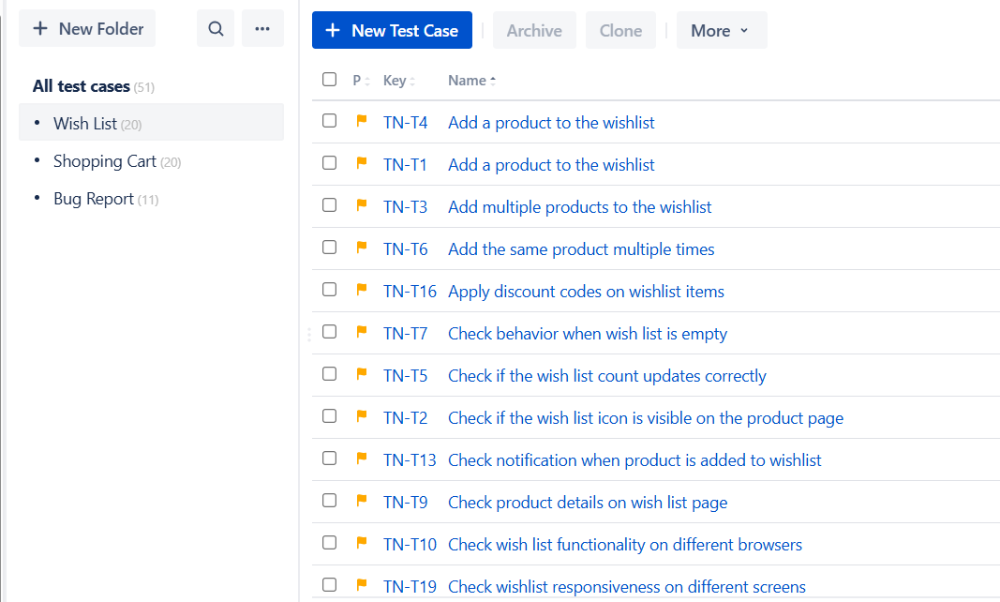
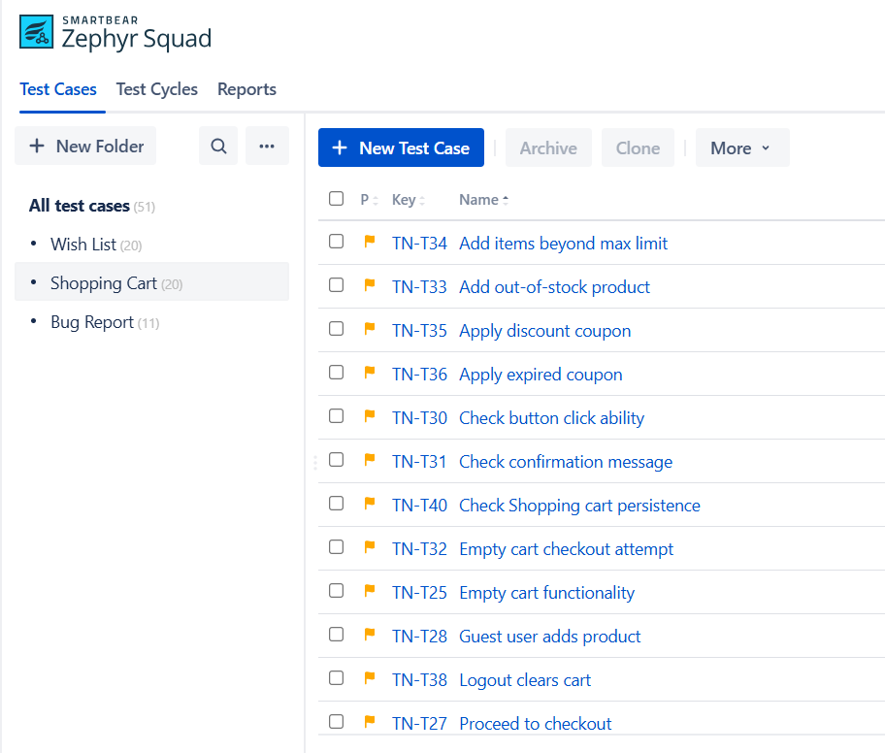
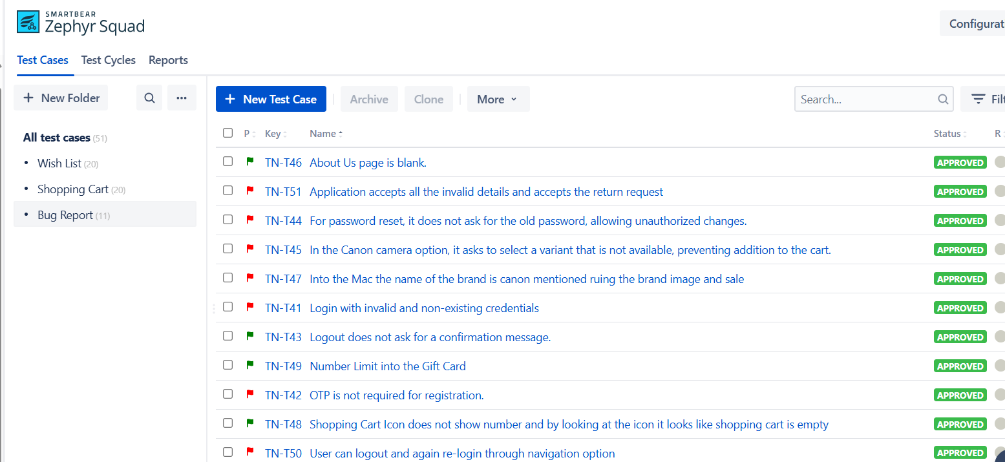

Slide 8
Thank You for Watching!
I Appreciate Your Time and Attention

